Slide 1
Algorithmic Curation & Personalization
JOUR479V/779V – Computational Journalism
University of Maryland, College Park
Nick Diakopoulos, Ph.D.

Slide 2
News Consumption
How do you find news that is interesting / relevant to you?
Strategies?
Tools?

Slide 3
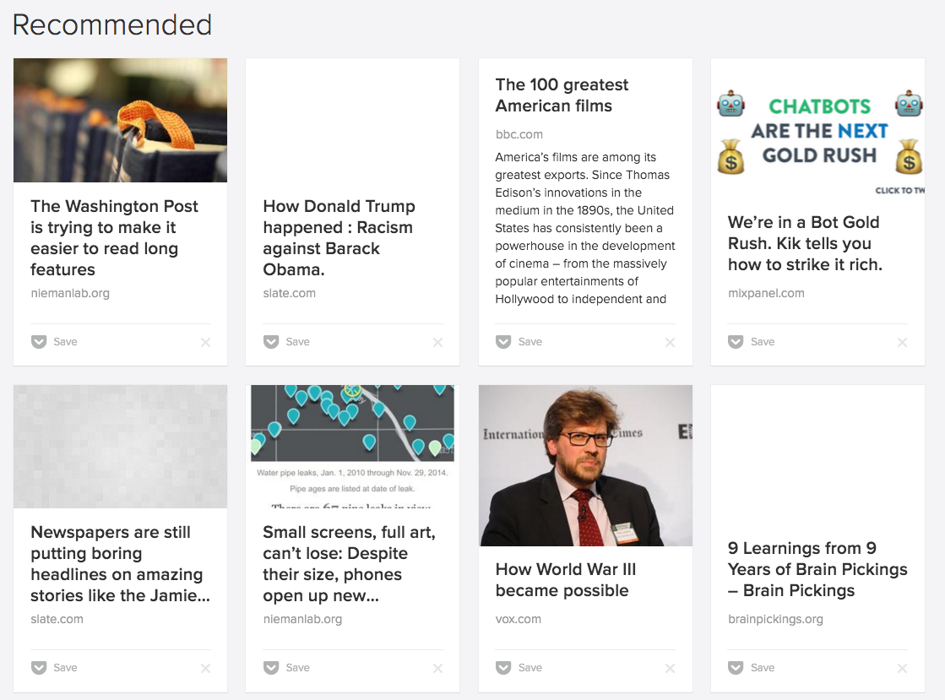
News Recommendation
Notes:
News recommendation helps deal with the issue of scale and finding the things that should be interesting to you but you don’t even know about.
In the case of pocket it’s based on the articles that I’ve saved in that app.

Slide 4
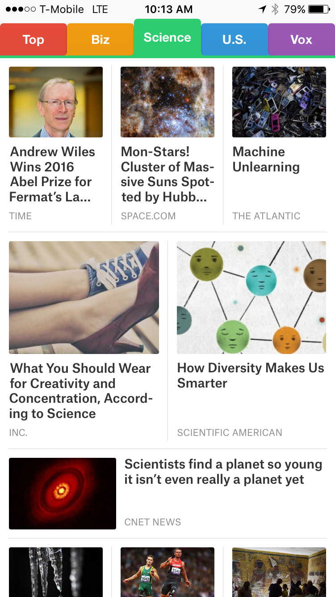
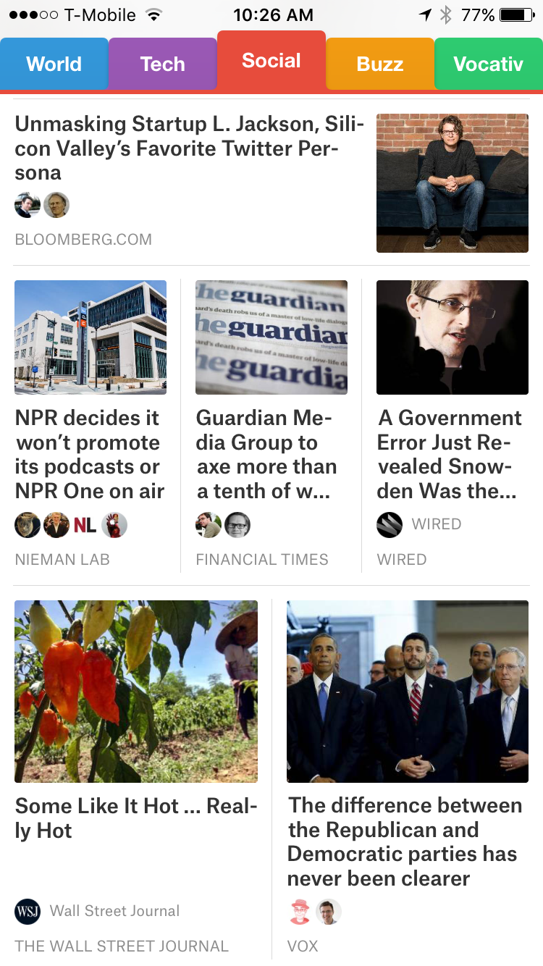
News Recommendation
Notes:
Smart News App says that it “curated the must-read stories that matter now”. It also has a social tab where it mines the stories that your contacts are sharing.

Slide 5
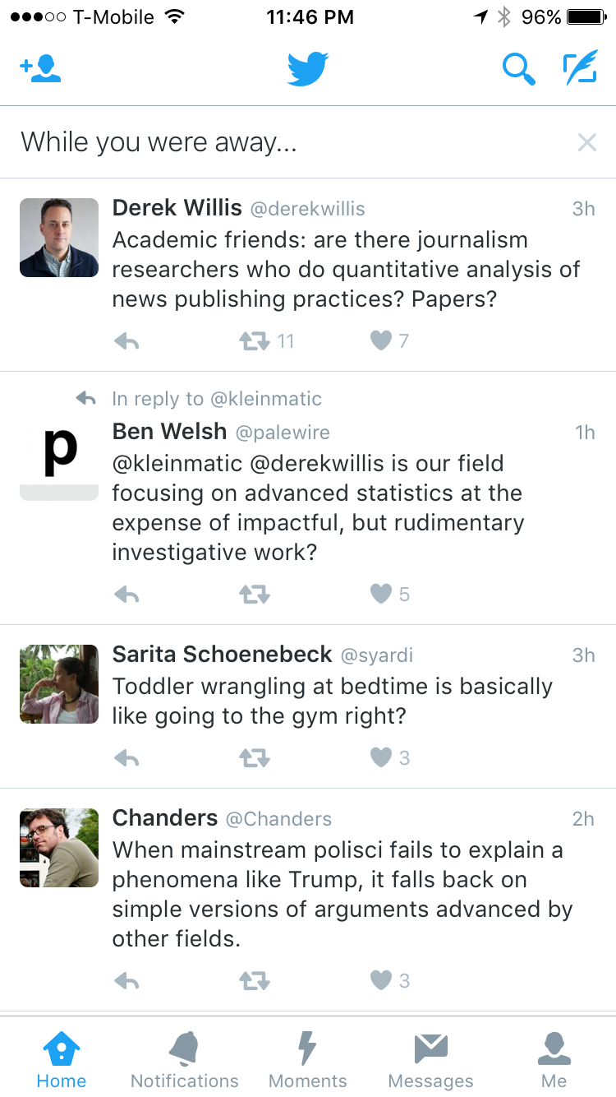
Feed Curation
“You may see a summary of the most interesting Tweets you received since your last visit, labeled as While you were away.”
“Tweets you are likely to care about most will show up first in your timeline. We choose them based on accounts you interact with most, Tweets you engage with, and much more.”
https://support.twitter.com/articles/164083
Notes:
Feed curation is a sort of special case of news recommendation, where it’s a recommendation for what to pay attention to from a set of things that you’ve already curated and which are presented in some chronological flow.
What are the pro / cons to seeing a curated list versus seeing everything? Curated content versus having already curated the people I want to pay attention to b/c I’ve vetted the person and I know that person can provide a bit of serendipity within their range.

Slide 6
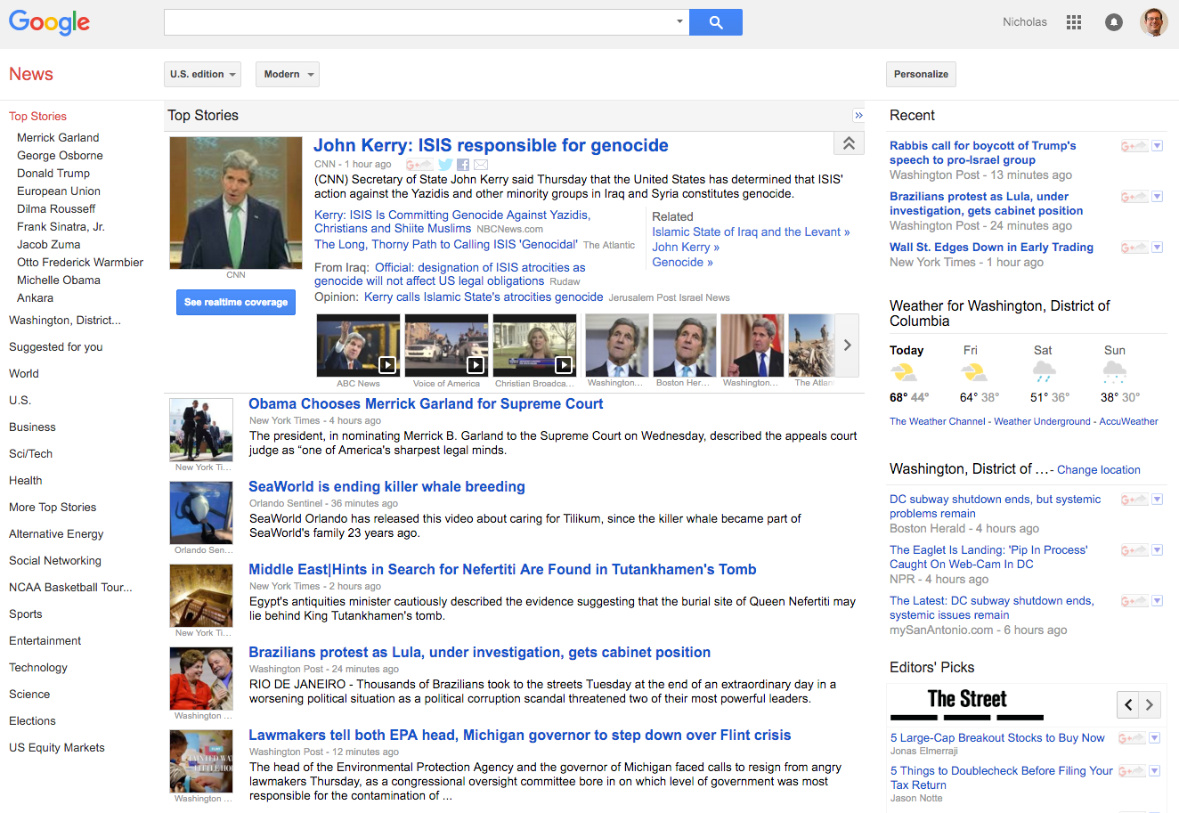
Portal Personalization
news.google.com
Notes:
Walk through the various personalization options on Google.
Personalization vs. adaptation
News cluster summarization is also in use on google. What sites get selected as representative?
Why does this even matter? Filter bubble is one concern.

Slide 7
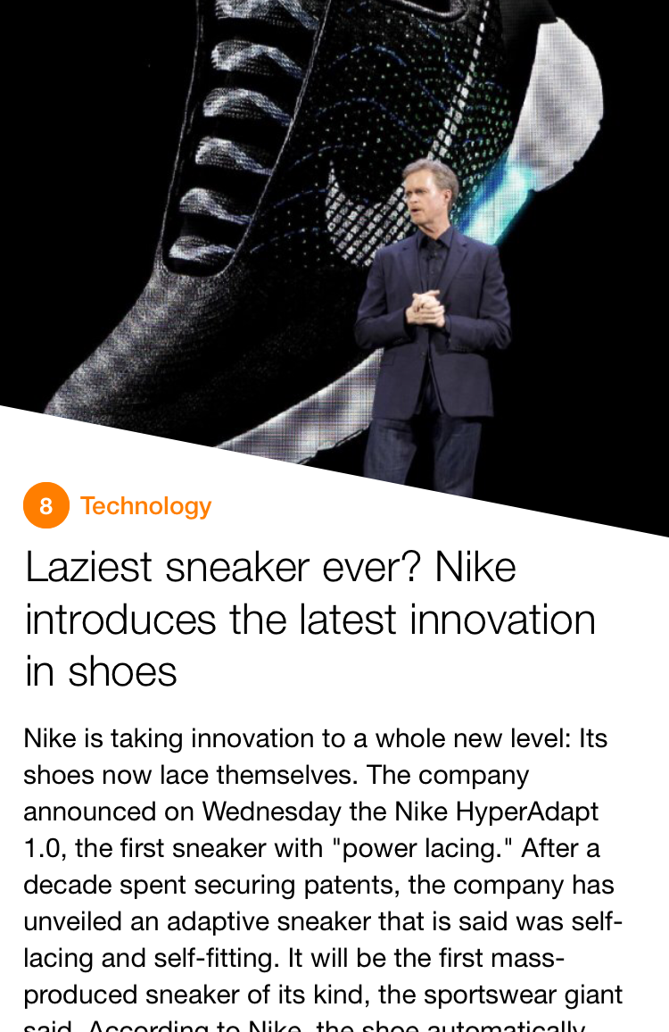
Summarization from Article Groups
https://mobile.yahoo.com/newsdigest/
Notes:
Yahoo news digest
My understanding is that while the articles themselves are summarized, the choice of exactly *which* articles to include in the twice daily briefing is also moderated by a human editor who is using analytics to make decisions.

Slide 8
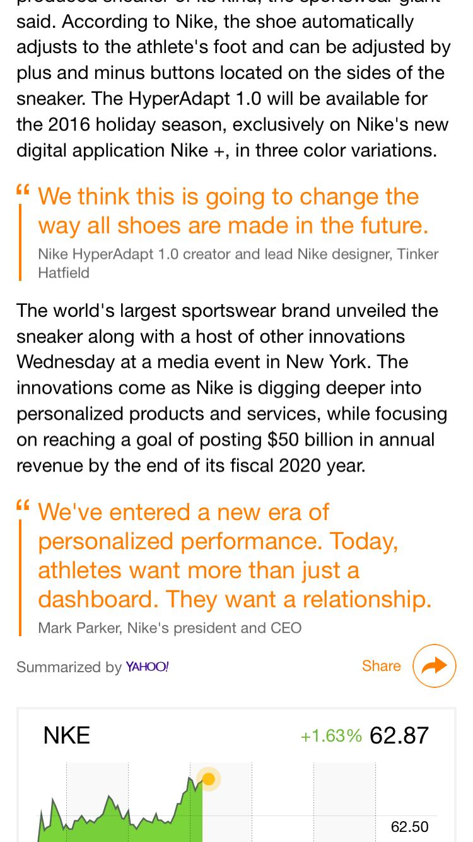
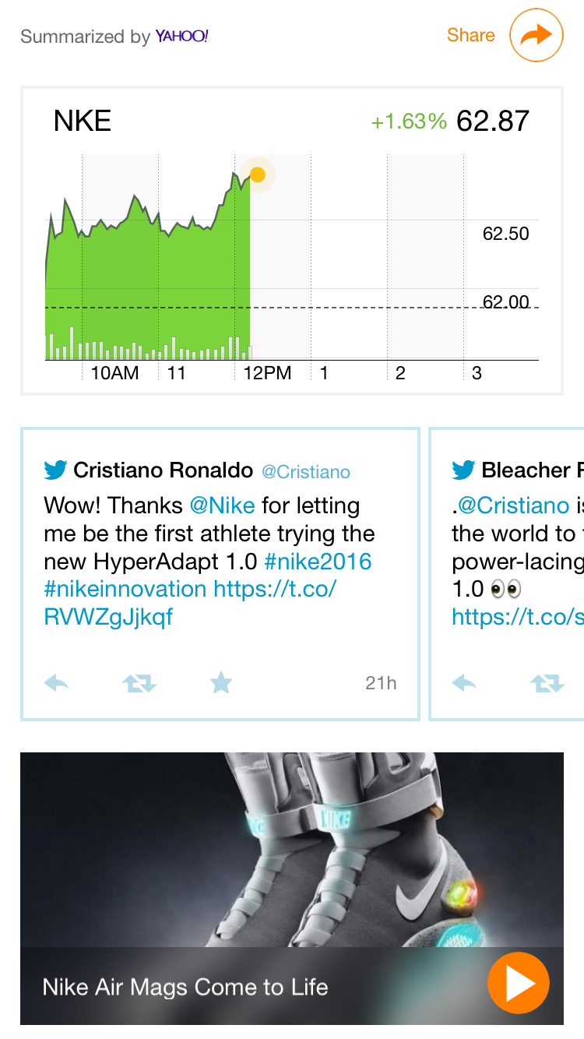
Notes:
They’re also adding a lot of context … like stock charts, tweets / reactions, videos, maps,

Slide 9
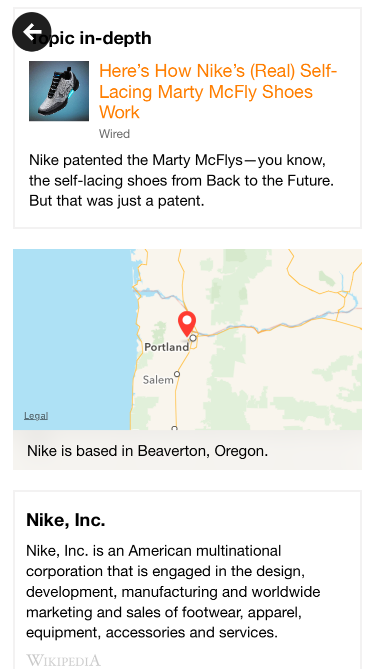
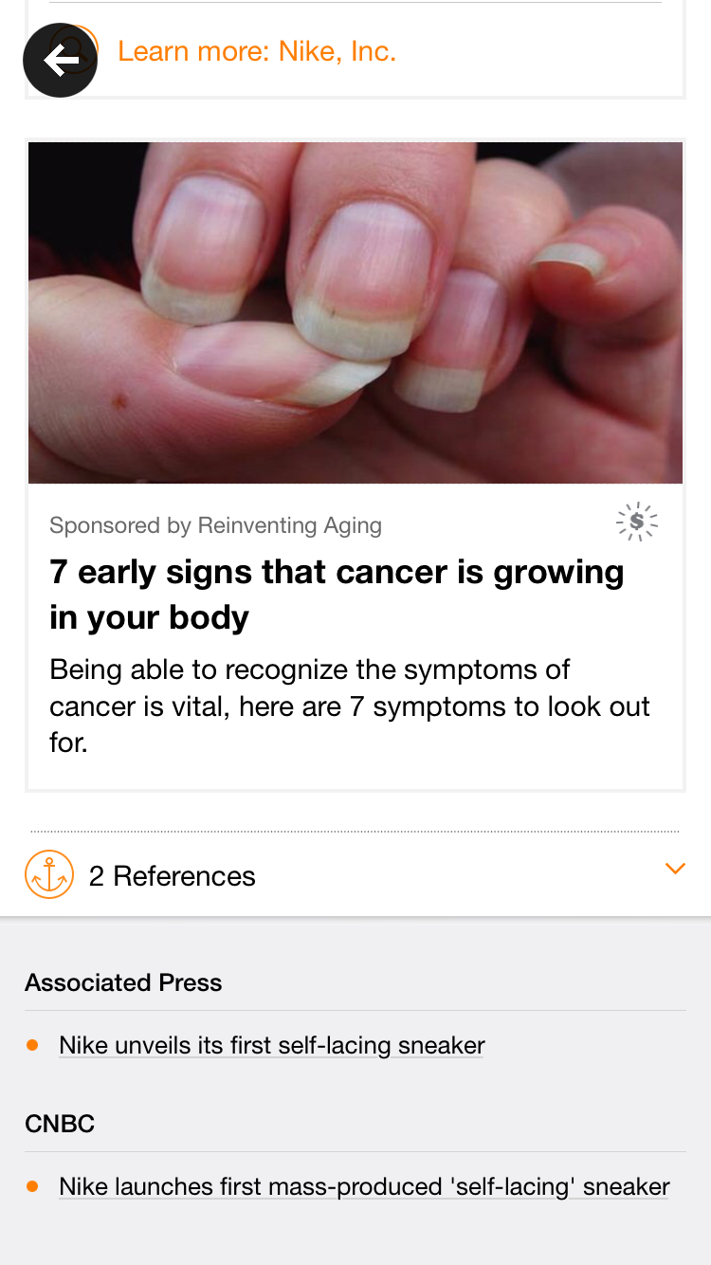
Notes:
And at the very bottom below the ads are the original references from which the story was summarized.

Slide 10
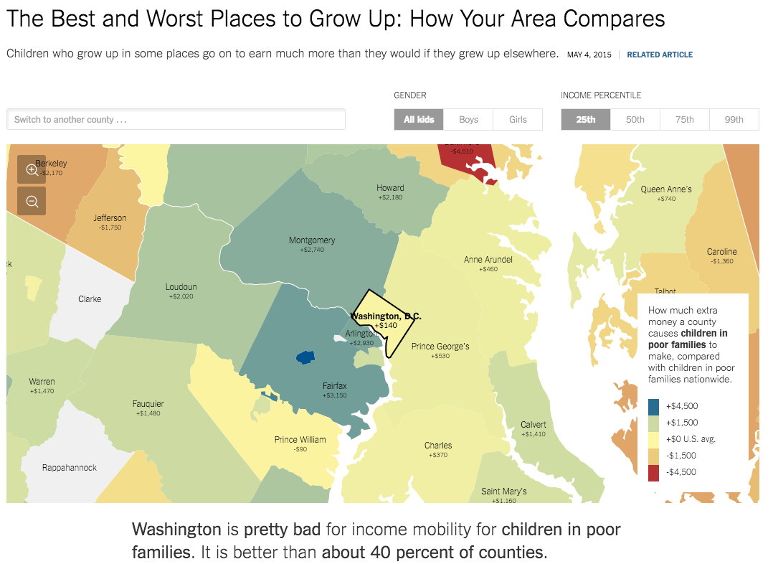
Content Personalization
http://www.nytimes.com/interactive/2015/05/03/upshot/the-best-and-worst-places-to-grow-up-how-your-area-compares.html
Notes:
How do we still have conversations about the same thing if everyone sees a different version?
Are there privacy issues related to this?

Slide 11
Readings
Bias in algorithmic filtering and personalization
Can algorithms really replace human news filters (i.e. gatekeepers)? What’s the big deal if they do?
Do you trust algorithmic intermediaries of news information like FB, Twitter, etc.?
How are user profiles constructed for these systems?

Slide 12
Readings
Building the NYT Recommendation Engine
What’s the difference between content-based recommendation and collaborative filtering?
What are some of the pitfalls of recommendation systems that the engineers at NYT are trying to avoid?
Notes:
Content-based recs are based on tags (i.e. the content itself). Whereas collaborative filteringis based on finding similar people to you (e.g. read same types of articles).
Pitfalls: what if a reader misses something they would be really in to? Filter bubble? Inability to recommend newly-published unexplored articles.

Slide 13
Readings
Facebook Wants you to Vote …
What are the democratic implications of Facebook, and now Twitter, Instagram and others curating what we see?
How is algorithmic media curation different or the same from traditional media?
Notes:
Bias: over or underemphasis, the formation of publics or groups of common interest
Difference: scale, opacity?, non-uniformity

Slide 14
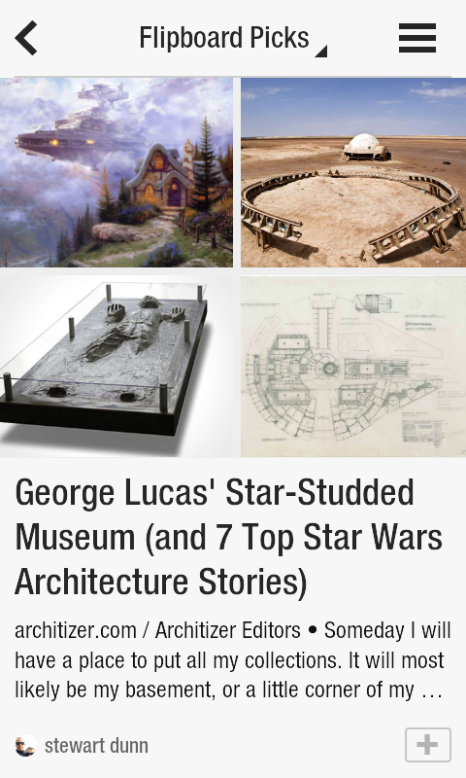
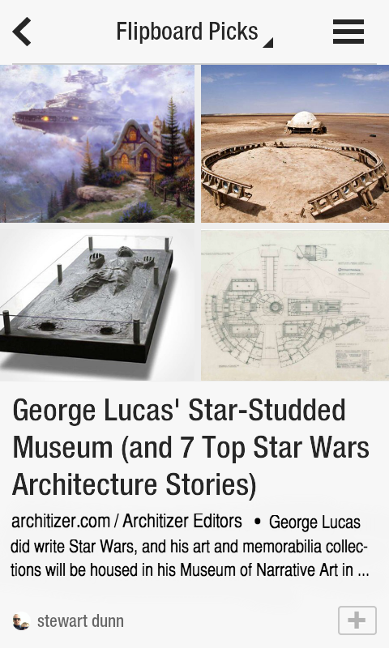
Readings
Flipboard’s approach to Automatic Summarization
How is text summarization similar to Google Search?
Notes:
They both use page rank to rank sentences based on their “centrality” or importance.

Slide 15
Break

Slide 16
Personalized News Design
Groups of three
Find a data story from e.g. 538, Upshot
At least a few hundred words long, maybe even with vis and interactivity
Now think about how to personalize the story based on user profile
For profile consider: Age, gender, education level, location, marital status, political affiliation, ??? e.g.: 65 year-old, woman, with a graduate degree living in Naples, Florida who is divorced and registered democrat
What can you add, change, subtract to make it more interesting / appealing to chosen user profile?
Be concrete about how the writing and information presentation would change. Create a mockup of the adapted story highlighting how you’ve changed it to appear to the target user profile.
Can you imagine a set of rules (an algorithm) that would allow a computer to do this personalization? Would it apply to other similar articles?
Present mockup back to class.

Slide 17
Questions?

